Slide 3
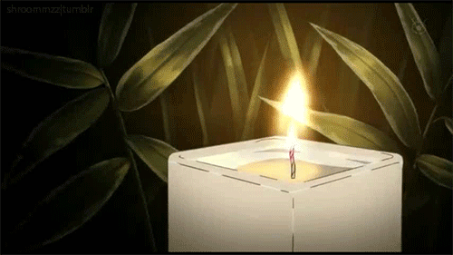
Lighting the Christ Candle

Slide 5
The Lord be with you
And also with you

Slide 6
Let us
pass the peace

Slide 8
1 Give thanks to the LORD,
for He is good; His love endures forever.
2 Let Israel say: "His love endures forever."

Slide 9
14 The LORD is my strength and my song; He has become my salvation.
15 Shouts of joy and victory resound in the tents of the righteous: "The LORD's right hand has
done mighty things!

Slide 10
16 The LORD's right hand is lifted high; “The LORD's right hand
has done mighty things!"
17 I will not die but live, and will proclaim what the LORD has done.

Slide 11
18 The LORD has chastened me severely, but He has not given me over to death
19 Open for me the gates of righteousness; I will enter and give thanks to the LORD.

Slide 12
20 This is the gate of the LORD through which the righteous may enter.
21 I will give You thanks,
for You answered me; You have become my salvation.

Slide 13
22 The stone the builders rejected has become the capstone;
23 the LORD has done this, and it is marvellous in our eyes.

Slide 14
24 This is the day
the LORD has made; let us rejoice and be glad in it.
Amen

Slide 16
All glory, praise, and honour
To You, O Christ, we sing, To whom the lips of children
Made sweet hosannas ring!
You are the king of Israel
You are David’s royal son
Who came in the Lord’s name
As king and blessed one.

Slide 17
All glory, praise, and honour
To You, O Christ, we sing.
O Promised One of Israel,
Of David's royal line,
The company of angels
Are praising you on high
And mortals and all creatures
exultant make their reply.

Slide 18
All glory, praise, and honour
To You, O Christ, we sing.
As You received their praises,
Receive our prayers today,
The people of the Hebrews
with palms before you went
and prayer and anthems
we offer you this day.

Slide 19
All glory, praise, and honour
To You, O Christ, we sing, To whom the lips of children
Made sweet hosannas ring!
To You before Your passion
They sang their hymns of praise
To You now exalted high
Our Melody of praise.

Slide 20
All glory, praise, and honour
To You Redeemer king
To whom the lips of children
Made sweet hosannas sing
You did receive our praises
Accept the prayers we bring
You delight in right living
Good Lord and gracious King.

Slide 23
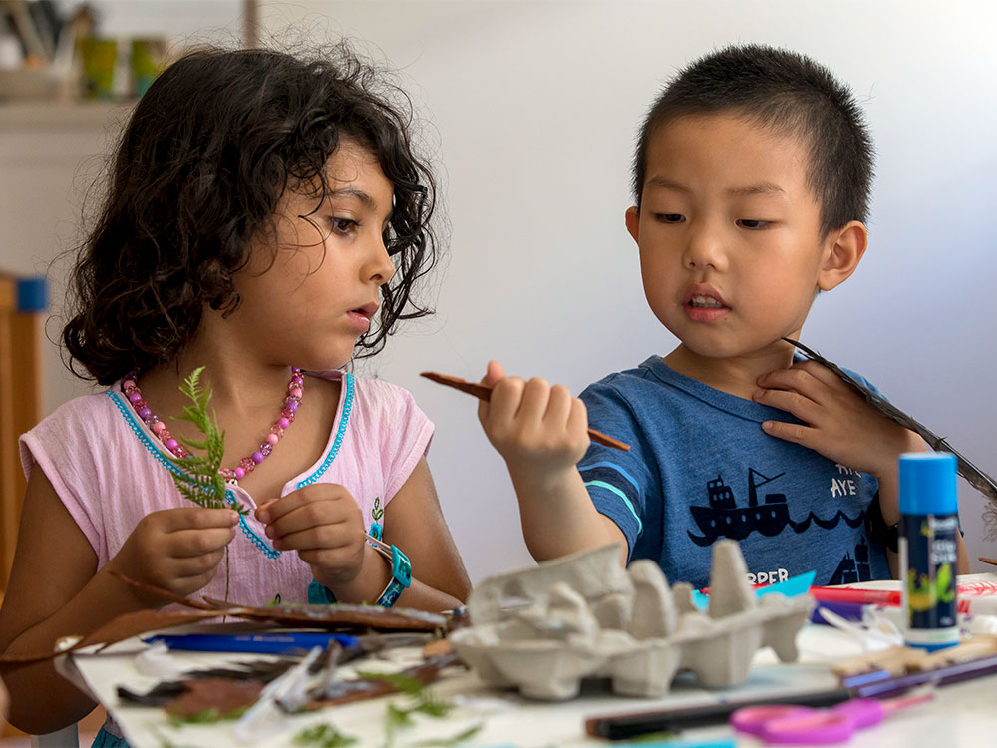

Slide 24
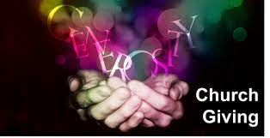

Slide 26
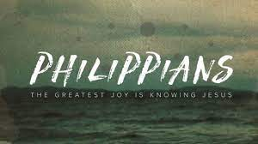

Slide 27
2 Therefore if you have any encouragement
from being united with Christ,
if any comfort from his love,
if any common sharing in the Spirit,
if any tenderness and compassion,
² then make my joy complete by being like-minded, having the same love, being one in spirit
and of one mind. ³ Do nothing out of selfish ambition or vain conceit. Rather, in humility value others above yourselves, ⁴ not looking to your own interests
but each of you to the interests of the others.

Slide 28
⁵ In your relationships with one another,
have the same mindset as Christ Jesus:
⁶ Who, being in very nature God, did not consider equality with God something to be used to his own advantage; ⁷ rather, he made himself nothing by taking the very nature of a servant, being made in human likeness.

Slide 29
⁸ And being found in appearance as a man, he humbled himself by becoming obedient to death— even death on a cross!
⁹ Therefore God exalted him to the highest place and gave him the name that is above every name, ¹⁰ that at the name of Jesus every knee should bow, in heaven and on earth and under the earth, ¹¹ and every tongue acknowledge
that Jesus Christ is Lord, to the glory of God the Father.

Slide 32
11 As they approached Jerusalem and came to Bethphage and Bethany at the Mount of Olives, Jesus sent two of his disciples,
² saying to them, “Go to the village ahead of you, and just as you enter it, you will find a colt tied there, which no one has ever ridden.
Untie it and bring it here.
³ If anyone asks you, ‘Why are you doing this?’
say, ‘The Lord needs it
and will send it back here shortly.’”

Slide 33
⁴ They went and found a colt outside in the street, tied at a doorway. As they untied it,
⁵ some people standing there asked,
“What are you doing, untying that colt?”
⁶ They answered as Jesus had told them to,
and the people let them go.
⁷ When they brought the colt to Jesus
and threw their cloaks over it, he sat on it.
⁸ Many people spread their cloaks on the road, while others spread branches they had cut in the fields.

Slide 34
⁹ Those who went ahead
and those who followed shouted,
“Hosanna!”
“Blessed is he who comes in the name of the Lord!”
¹⁰ “Blessed is the coming kingdom
of our father David!”
“Hosanna in the highest heaven!”
¹¹ Jesus entered Jerusalem and went into the temple courts. He looked around at everything,
but since it was already late,
he went out to Bethany with the Twelve.

Slide 36
From heaven You came helpless babe
Entered our world,
Your glory veiled
Not to be served but to serve
And gave Your life that we might live.

Slide 37
This is our God, The Servant King,
He calls us now to follow Him,
To bring our lives as a daily offering
Of worship to the Servant King.

Slide 38
There in the garden of tears
My heavy load he chose to bear.
His heart with sorrow was torn,
"Yet not my will but Yours" He said.

Slide 39
This is our God, The Servant King,
He calls us now to follow Him,
To bring our lives as a daily offering
Of worship to the Servant King.

Slide 40
Come, see His hands and His feet,
The scars that speak of sacrifice,
Hands that flung stars into space
To cruel nails surrendered.

Slide 41
This is our God, The Servant King,
He calls us now to follow Him,
To bring our lives as a daily offering
Of worship to the Servant King.

Slide 42
So let us learn how to serve,
And in our lives enthrone Him,
Each other’s needs to prefer
For it is Christ we are serving.

Slide 43
This is our God, The Servant King,
He calls us now to follow Him,
To bring our lives as a daily offering
Of worship to the Servant King.

Slide 45
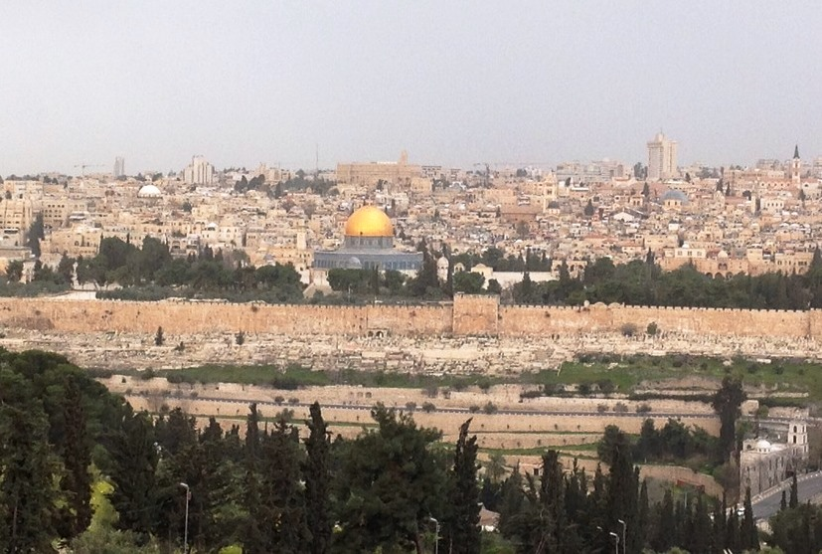
Jerusalem from the Mount of Olives or Olivet

Slide 46
• In Mark’s Gospel, there is no quotation from Zechariah 9:9 (Matt 21:5).
• Jesus rides a colt instead of a donkey and colt (Matt 21:2).
• The people spread “leafy branches that they had cut in the fields” in Jesus’ path (v. 8) instead of “branches of the palm trees” (Jn 12:13).
• In the hosannas, there is no mention of Jesus as Son of David ( Matt 21:9).
• Jesus does not weep over Jerusalem (Luke 19:41-44).

Slide 47
1As they approached Jerusalem, from Jericho, and came to Bethphage and Bethany,
the home of Martha, Mary and Lazarus
at the Mount of Olives, . “At the fall of Jerusalem in 586 B.C. Ezekiel had a vision of the glory of the Lord departing from Jerusalem and settling on the Mount of Olives (Ezek 11:23)”

Slide 48
Jesus sent two of his disciples, ² saying to them, “Go to the village ahead of you, and just as you enter it, you will find a colt, hardly the charge for a King to ride in victory, tied there, which NO ONE HAS EVER RIDDEN, like the tomb, never touched, unblemished.
Untie it and bring it here.

Slide 49
³ If anyone asks you, ‘Why are you doing this?’
say, ‘The Lord needs it and will send it back here shortly.’”, a bit like borrowing a car with the keys in the ignition, perhaps these men were known as friends of Jesus. ⁴ They went and found a colt outside in the street, tied at a doorway. As they untied it, ⁵ some people standing there asked,
“What are you doing, untying that colt?”
⁶ They ANSWERED AS JESUS HAD TOLD THEM TO, and the people let them go. They have showed their obedience to Jesus.

Slide 50
⁷ When they brought the colt, making something ordinary into significance, to Jesus and threw their cloaks, never saddled before, over it, he sat on it. A king would ride a horse into battle, but a donkey when coming in peace.
⁸ Many people, probably pilgrims, spread their cloaks on the road, like red carpet.
while others spread branches they had cut in the fields.

Slide 51
⁹ Those who went ahead and those who followed shouted,
“HOSANNA!” meaning “Save Us”
“Blessed is he who comes in the name of the Lord! Psalm 118:26”
¹⁰ “Blessed is the coming kingdom of our father David!” Oh for the great days of king David
“Hosanna in the highest heaven!” This could be seen as sedition by the Romans a provoke a stern armed response.

Slide 52
¹¹ Jesus entered Jerusalem and went into the temple courts. He looked around at everything, but since it was already late, they are tired, Jericho is 30 ks away and uphill, he went out to Bethany with the Twelve. The next day he returns to upturn life as they knew it. His triumph is not only the entry but what is to come….

Slide 54
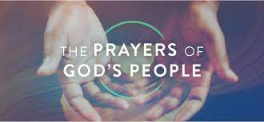

Slide 56
Our Father in heaven,
hallowed be Your name,
Your kingdom come,
Your will be done
On earth as in heaven.
Give us today our daily bread.

Slide 57
And forgive us our sins,
As we forgive those
who sin against us.
Save us from the time of trial,
And deliver us from evil.
For the kingdom, the power
and the glory are Yours,
Now and forever. Amen.

Slide 59
When we walk with the Lord In the light of His word, What a glory He sheds on our way While we do His good will, He abides with us still, And with all Who will trust and obey.
1/8

Slide 60
Refrain Trust and obey,
For there's no other way To be happy in Jesus,
But to trust and obey.
2/8

Slide 61
Not a shadow can rise, Not a cloud in the skies, But His smile quickly drives it away; Not a doubt nor a fear, Not a sigh nor a tear, Can abide while we trust and obey.
3/8

Slide 62
Refrain Trust and obey,
For there's no other way To be happy in Jesus,
But to trust and obey.
4/8

Slide 63
But we never can prove The delights of His love Until all on the altar we lay; For the favour He shows, And the joy He bestows, Are for those who will trust and obey.
5/8

Slide 64
Refrain Trust and obey,
For there's no other way To be happy in Jesus,
But to trust and obey.
6/8

Slide 65
Then in fellowship sweet We will sit at His feet, Or we'll walk by His side in the way What He says we will do, Where He sends we will go; Never fear, only trust and obey.
7/8

Slide 66
Refrain Trust and obey,
For there's no other way To be happy in Jesus,
But to trust and obey.
8/8

Slide 68
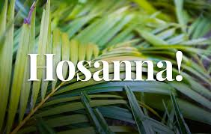

Slide 69
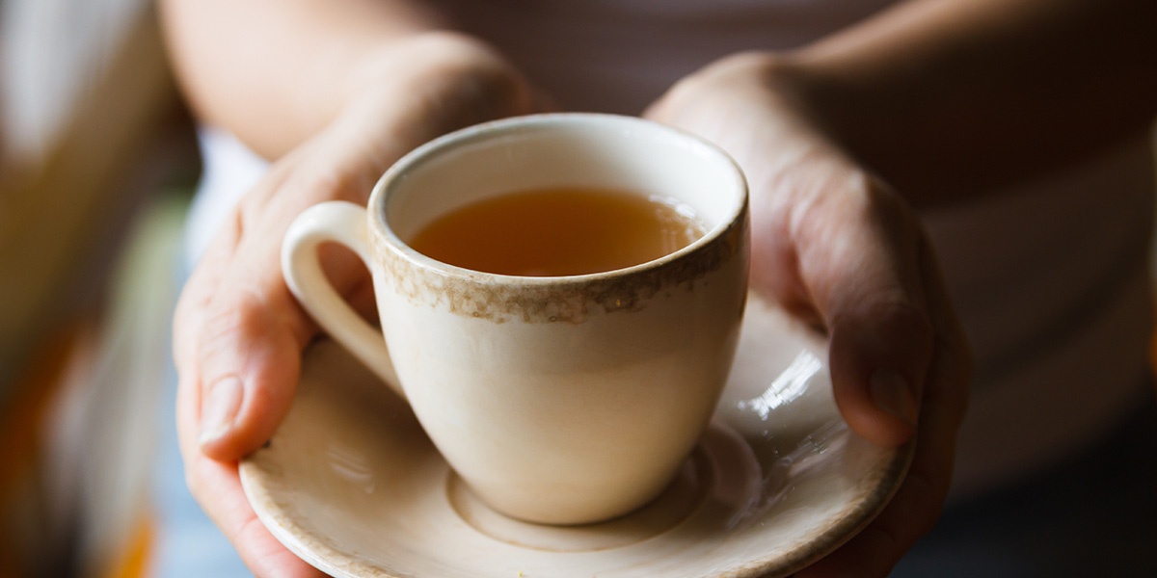
Morning
Good
Have a Great week

Slide 70
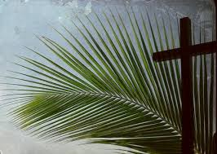

Slide 71
